Slide 1
Manhattan Congestion Relief Zone Forecasting
Group 30 Members: Sriathmiha K Bhaskaran, Sarah Friedrichs, Nimit Sharma, Anoosha Thumma, Emily Jin Yang

Slide 2
01
Introduction

Slide 3
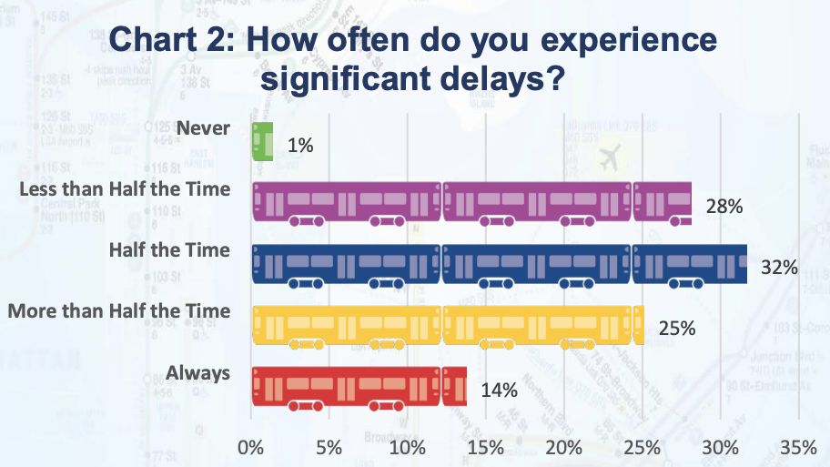
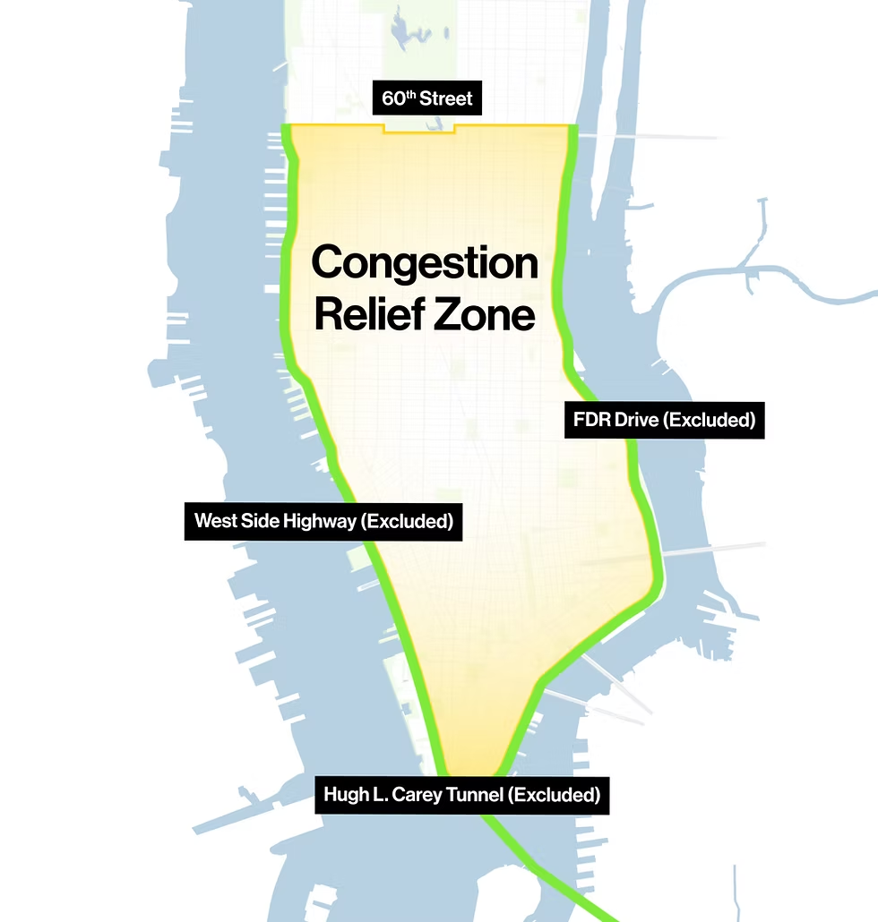
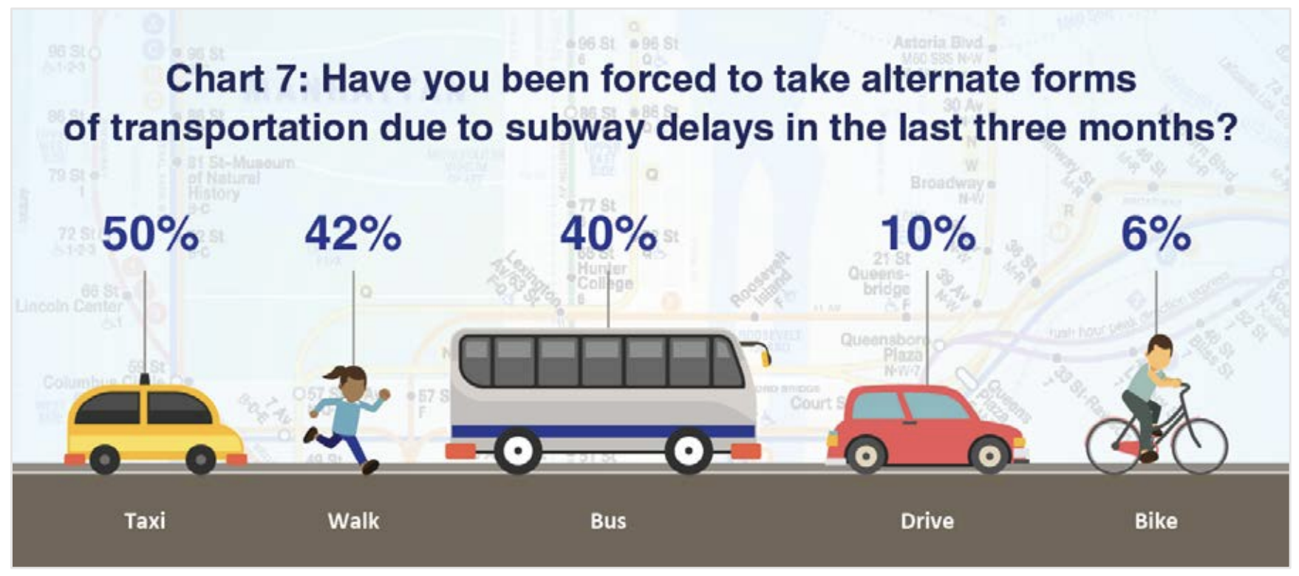
Problem
NYC’s Metropolitan Transportation Authority (MTA) introduced a Congestion Relief Zone (CRZ) in January of this year, requiring tolls on vehicles entering the area.
We are interested in using forecasting to analyze the efficacy of the CRZ, accounting for interactions between vehicle traffic and NYC public transit.
[4]
[4]
[2]
Notes:
This year, the Metropolitan Transportation Authority (MTA) introduced a Congestion Relief Zone (CRZ) in NYC, requiring tolls on vehicles entering the area. But urban congestion in NYC persists. MTA surveys also show that subway delays frequently push riders to taxis, which public reporting on traffic rarely models. A short-term forecasting system integrating both could support tolling strategies to reduce emissions and ensure fair pricing.

Slide 4
02
Data Cleaning

Slide 5
Data Sources
Traffic Dataset:
2.69M rows and 14 columns
Maintained by the MTA since the CRZ’s launch in January
Broken down into 10-minute intervals
Vehicle counts, toll period (rate), vehicle type, detection point/region
NYC Subway Dataset:
Details daily operations since 2021
Trip metadata (e.g., route, direction, start time, vehicle, schedule changes, etc.)
Stop-level details (e.g., track assignments, arrivals, departures, etc.)
Notes:
Traffic Dataset: Maintained by the MTA, tracks CRZ entries, and broken down into 10-minute intervals of the day.
NYC Subway Dataset: Daily operations since 2021, including route, schedule changes, arrivals, departures, etc.

Slide 6
Data Cleaning
~393k rows, 88 features
1 row = 1 vehicle type at 1 detection region during 1 interval
Temporal alignment: Join subway and traffic datasets on 10-minute intervals
Missing data: Drop subway trips containing nulls in any column (<2%)
Day of the week: 7 encoded values
Tolling period: 2 encoded values (overnight or peak); determines the tolling rate
Vehicle class: 6 encoded values (car, single unit truck, multi-unit truck, bus, taxi, etc.)
Detection region: 7 encoded values corresponding to CRZ detection regions
Rolling means: Avg # entries of same vehicle class at same region over last 30m [*supervised only]
Subway trips: Count of operating trips in the current interval
Subway routes: Encode {route, direction} pairs (e.g., ‘route_H_1’) into 60 binary features
Subway delays: Average deviation from expected last-seen time for a specific, route, direction, and time of day (e.g., all northbound 7-line trips starting between 8-8:10AM)
Notes:
We had around 400k rows and 88 features (August through October), with each row representing the number of entries of a specific vehicle type at a specific detection region during a specific 10 minute interval.
There are two targets based on the two types of entries into the CRZ: regular entries and excluded roadway entries (i.e., through roads exempt from tolls).
These are some of our different traffic and subway related features. Then, to set the task up as a time series for the supervised models, for each target variable, we added a rolling mean of entries of the same vehicle class and detection region over the previous three intervals.
Since the MTA traffic dataset is reported in 10-minute intervals, the subway and traffic datasets were joined on corresponding intervals.
Fewer than 2% of all rows contained null values, so those rows were dropped.
From the traffic data, we encoded the day of the week, tolling period, vehicle class, and detection region. Then, to set the task up as a time series for the supervised models, for each target variable, we added a rolling mean of entries of the same vehicle class and detection region over the previous three intervals.
For the subway data, we created features for the active routes, the number of trips running, and to analyze delays, we averaged how much trips deviated from their expected last-seen time based on its route, direction, and the time of day.

Slide 7
03
Clustering

Slide 8
Overview
Factor Analysis of Mixed Data (prince.FAMD):
PCA for continuous variables combined with MCA for categorical variables
HDBSCAN (hdbscan.HDBSCAN):
Identifies clusters of varying density by building a hierarchy of potential clusters and selecting the most stable ones, rather than requiring a single global density threshold
Data Preparation:
Chronologically split data into training (30%), val (15%), test (15%) before reduction
Fit FAMD to training set, then separately transform validation and test sets
Fit HDBSCAN model on reduced training set (then predict on val/test)
*Unsupervised only; RF and XGB do not require normalization or feature reduction
Notes:
We wanted to use clustering to identify recurring patterns and isolate anomalies (e.g., major subway disruptions). We decided to use HDBSCAN given our high dimensional, mostly sparse feature space and the likelihood that clusters would have uneven density across different times/regions. HDBSCAN is an extension of DBSCAN that builds a hierarchy of potential clusters and selects the most stable ones.
We don’t need normalization or feature reduction with our supervised models because they’re both tree-based, but we did implement an FAMD model to use with HDBSCAN. FAMD handles mixed types of features at the same time.
And to prevent data leakage, the dataset was chronologically split into training, validation, and test sets before any reduction or clustering.

Slide 9
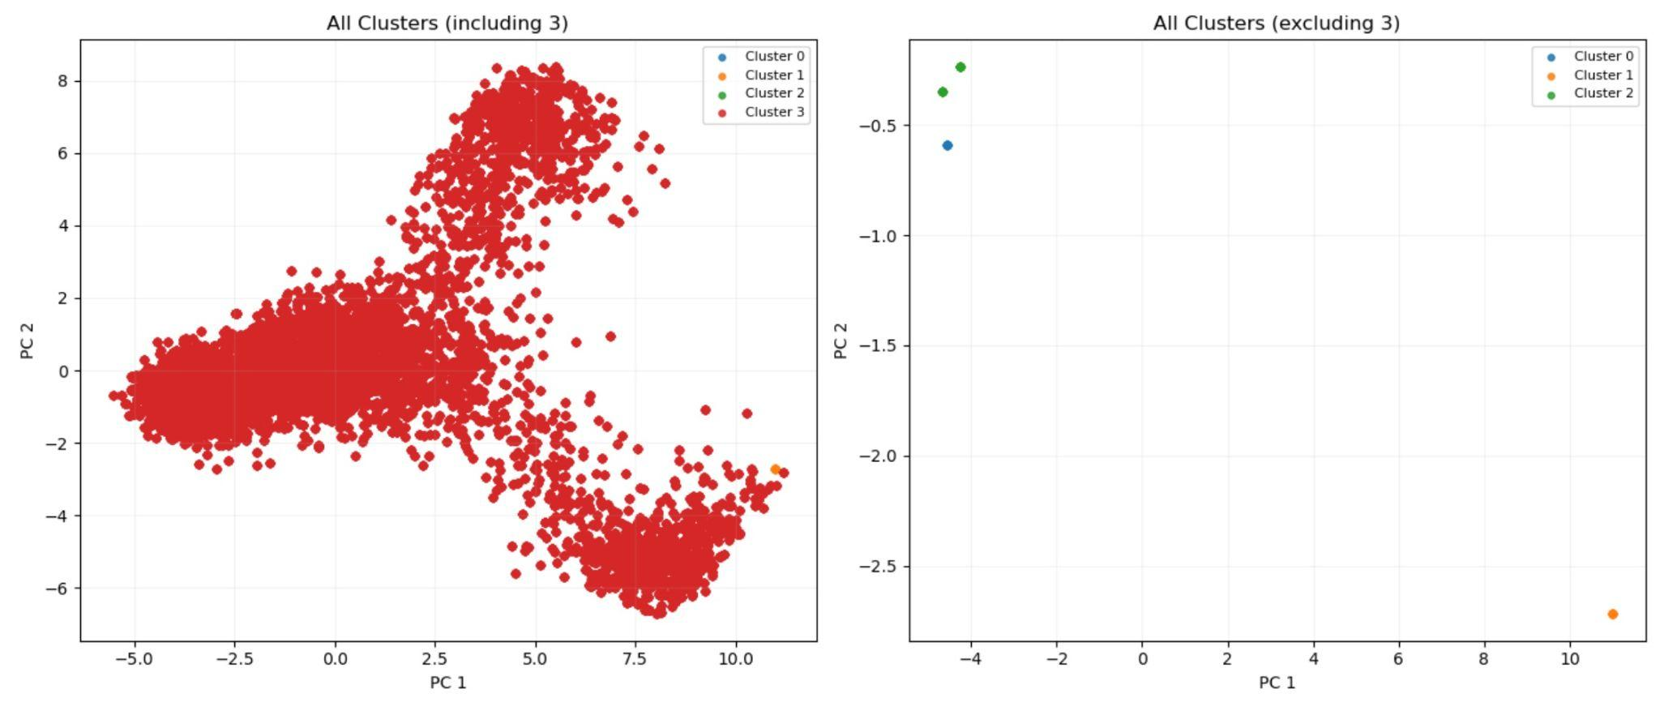
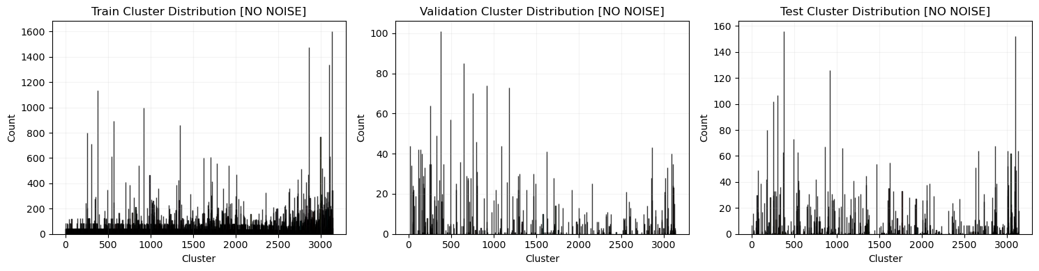
Tuning
Grid search on silhouette score, DBI, and noise:
n_components (FAMD) = 8
min_cluster_size (HDBSCAN) = 30
Smallest group to be considered a cluster
min_samples (HDBSCAN) = 20
Neighbors needed to be in a cluster
distance metric (HDBSCAN) = ‘euclidean’
cluster selection (HDBSCAN) = ‘eom’
Choose final cluster set from hierarchy by prioritizing stable, well-separated clusters
Intentionally selected lower silhouette and higher DBI but more even and granular distribution
Notes:
We did grid search on the silhouette, DBI, and noise percent to pick hyperparameters for FAMD and HDBSCAN simultaneously. The min cluster size controls the smallest group that should be considered a cluster, and min samples controls how many neighbors a point must have. And we went with the standard combination of Euclidean distance and Excess of Mass cluster selection.
Our first version of this model identified only four clusters, with 99% being assigned to a single cluster. So to capture more granular or event-specific behavior (e.g., subway disruptions) as opposed to very broad patterns (e.g., standard rush hours), we did intentionally select a combination that produced a more even distribution at the cost of slightly less optimal scores.

Slide 10
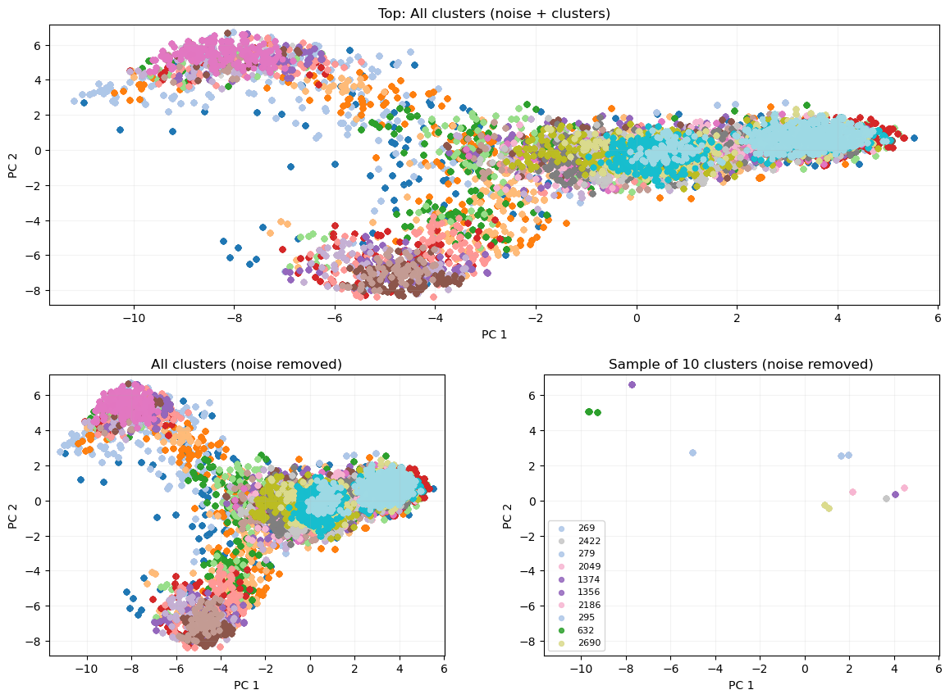
Results
n = 3138, silhouette = 0.349, DBI = 0.91
Notes:
The current version of the clustering model achieves a silhouette of 0.349 and a DBI of 0.91, with ~3000 clusters total.
The updated configuration did successfully uncover a more detailed clustering structure, which in theory, could align with irregular traffic events. The silhouette score is a little low, but this is pretty normal for high-dimensional, real-world data. The DBI is also still close to 0, so intra-cluster distances are small compared to inter-cluster distances.

Slide 11
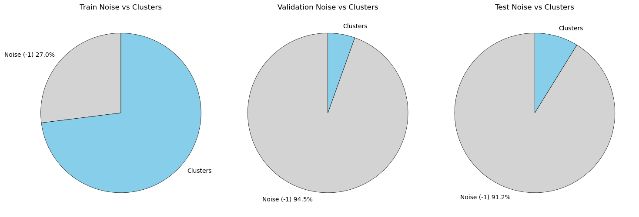
Results
Notes:
The noise percentage for the validation and test sets is still high. This suggests that the clustering structure is still not as generalizable as we had hoped. Because HDBSCAN is density-based, this probably means the validation and test datasets don’t occupy the same dense regions of the feature space as the training data. The three sets cover different periods of time, and traffic patterns change over time. Also, the validation and test sets may have lower overall density because they are smaller than the training set, making it harder to meet the model’s density thresholds.

Slide 12
04
Random Forest Regression
Notes:
Nimit

Slide 13
Overview
Random Forest Regressor (sklearn.ensemble.RandomForestRegressor):
Combine predictions across many randomly constructed decision trees
Multi Output Regressor (sklearn.multioutput.MultiOutputRegressor):
Handles weights and predictions for two target variables
Data Preparation:
Does not require normalization or feature reduction
Add computed rolling mean features back into the dataset
Add a feature for generated cluster labels (casted as category)
Train, validation, and test splits prior to FAMD carried over
Notes:
For forecasting, we decided to start with Random Forest Regression as a strong baseline that can capture short-term dependencies and nonlinear interactions. Random Forest Regression is a tree-based ensemble model that combines predictions across many randomly constructed decision trees to produce a single output for each data point.
For data prep, we just added the rolling mean features back, as well the generated cluster labels. The pre-reduction train, validation, and test sets split before FAMD were carried over.

Slide 14
Tuning
Randomized grid search (sklearn.model_selection.RandomizedSearchCV) on R^2:
n_estimators = 200
Number of trees in forest
max_depth = 20
Maximum depth of each individual tree
min_samples_split = 10
Number of samples needed to split node
min_samples_leaf = 1
Minimum samples required in leaf node
max_features = 0.3
No. of features considered when choosing each split
Used sklearn.model_selection.TimeSeriesSplit with n_splits = 3 to create the cross validation splits without data leakage
Notes:
We randomly sampled combinations from a parameter grid of ~2,600 combinations and evaluated each configuration using cross-validation on the R^2 score. These are the hyperparameters that gave the best results.
The Random Forest Regressor model has parameters for the number of trees, the maximum depth of each tree, the samples required to split a node, the samples required in a leaf, and how many features to consider for each split.

Slide 15
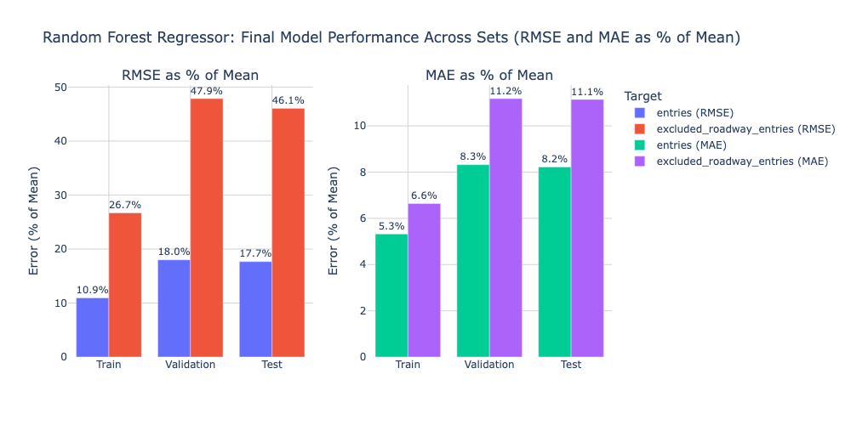
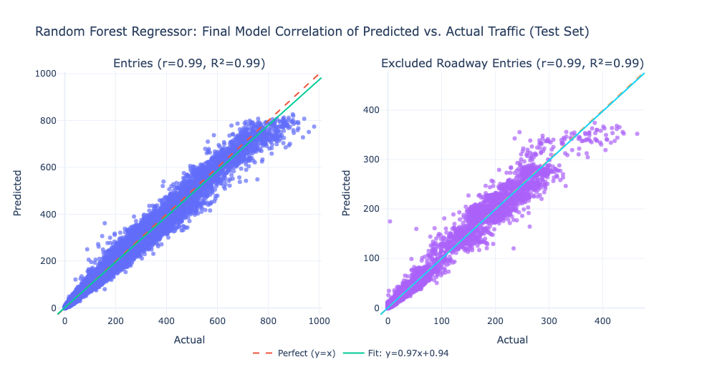
Results
 | R^2 (New Clustering Labels)
Set | Entries | Excluded Roadway Entries
Train | 0.9961 | 0.9953
Validation | 0.9893 | 0.9848
Test | 0.9895 | 0.9857
 | R^2 (Old Clustering Labels)
Set | Entries | Excluded Roadway Entries
Train | 0.9961 | 0.9952
Validation | 0.9893 | 0.9850
Test | 0.9896 | 0.9858
Notes:
We evaluated using Mean Absolute Error (MAE) and Root Mean Squared Error (RMSE), which are the standard for forecasting, as well as R^2 as a rough measure of correlation. Overall, the results are very strong, with minimal overfitting.
The R^2 is around .98-99 for the validation and test sets, and the RMSE and MAE around 18% and 8% are robust for real-world data, especially given that the degree of correlation between subway activity and CRZ inflow was unknown. These results suggest that subway and traffic trends in NYC are meaningfully related, and that subway trip data can support forecasting for tolling policy.
Performance was weaker on excluded_entries. But these reflect broader regional traffic behavior, and the toll exemption may introduce variability in driver behavior. So lower performance is expected.
That said, the results are nearly identical as with the old clustering. So the patterns captured by the clustering may be redundant with the other features, or the Random Forest model may already be robust enough without clusters.

Slide 16
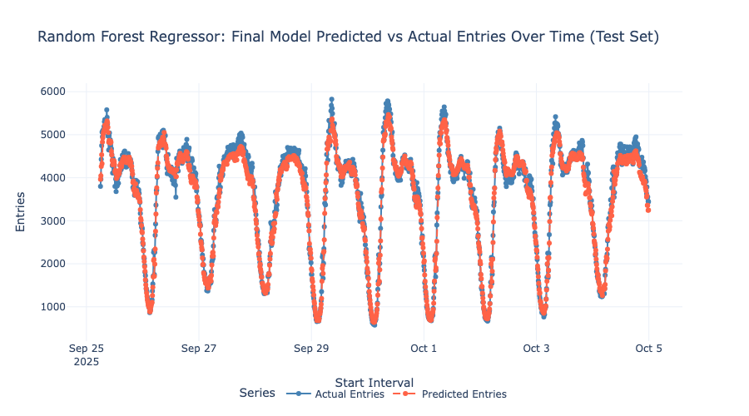
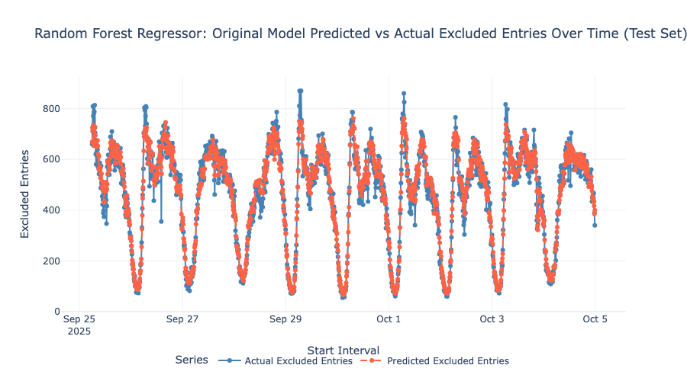
Results
Notes:
Here we see that the RF model tends to miss more extreme points for both targets but captures the predictable rise-and-fall in traffic volume through the day.

Slide 17
05
XGBoost Regression

Slide 18
Overview
XGBoost (xgb.Regressor):
Gradient-boosted decision-tree model that constructs many trees in sequence that reduce the errors of earlier trees, then sums their outputs into a final prediction
Multi Output Regressor (sklearn.multioutput.MultiOutputRegressor):
Handles weights and predictions for two target variables
Data Preparation:
Does not require normalization or feature reduction
Add computed rolling mean features back into the dataset
Add a feature for generated cluster labels (casted as category)
Train, validation, and test splits prior to FAMD carried over
Notes:
We planned to compare the Random Forest model to XGBoost, which iteratively minimizes errors.
XGBoost is another tree-based ensemble model that constructs many trees in sequence, where each tree is trained to reduce the errors of earlier trees. Since XGB does not require normalization or feature reduction either, the data preparation was identical to the Random Forest model.

Slide 19
Tuning
Randomized grid search (sklearn.model_selection.RandomizedSearchCV) on R^2:
n_estimators = 600
Number of trees / boosting rounds
max_depth = 4
Maximum depth of each individual tree
learning_rate = 0.1
Step size controlling how much each tree contributes to the prediction
col_sample_bytree = 1
Fraction of features sampled for each tree
reg_lambda = 1.0
L2 regularization term on leaf weights
Used sklearn.model_selection.TimeSeriesSplit with n_splits = 3 to create the cross validation splits without data leakage
Notes:
As before, we randomly sampled combinations from a parameter grid and evaluated each configuration using cross-validation on the R^2 score. These are the hyperparameters we found.
The model has parameters for the training rows sampled for each tree, the regularization term, the number of trees, the maximum depth of each tree, the step size controlling how much each tree contributes, and features sampled for each tree.

Slide 20
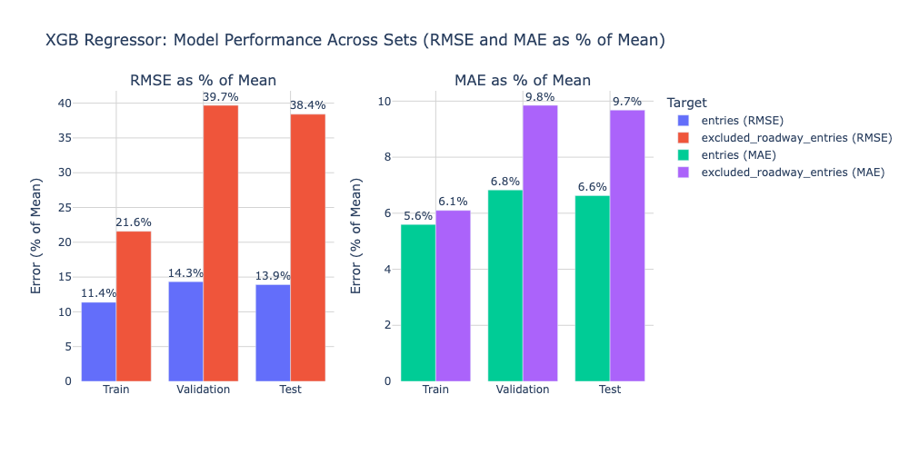
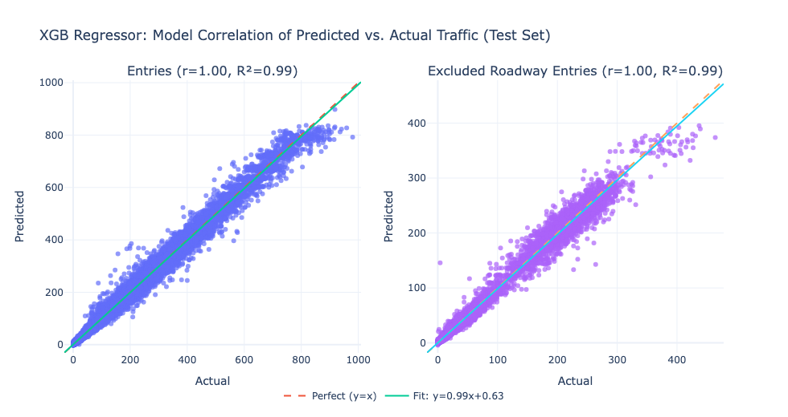
Results
 | R^2
Set | Entries | Excluded Roadway Entries
Train | 0.9959 | 0.9969
Validation | 0.9932 | 0.9896
Test | 0.9934 | 0.9901
Notes:
Again, the error values for both targets are very strong and reinforce the conclusions that (a) the Congestion Zone is a strong candidate for forecasting, and (b) subway patterns can be meaningful to traffic predictions. Performance is also weaker for excluded entries again, most likely for the reasons we previously discussed.

Slide 21
XGB vs. RF
Entries: -3 RMSE, -1.5 MAE
Excluded entries: -0.8 RMSE, -0.15 MAE
R^2: +0.004
RF Test R^2
Entries | Excluded Entries
0.9895 | 0.9857
XGB Test R^2
Entries | Excluded Entries
0.9934 | 0.9901
Notes:
XGB outperforms the Random Forest model across all metrics and both target variables. For regular entries, XGBoost reduces RMSE by ~3 vehicles and MAE by ~1.5 vehicles. For excluded entries, XGB lowers RMSE by ~0.8 vehicles and MAE by ~0.15 vehicles. The test R^2 for both targets is increased by 0.004 to >0.99. Overall, XGB generalizes better due to its boosting framework.

Slide 22
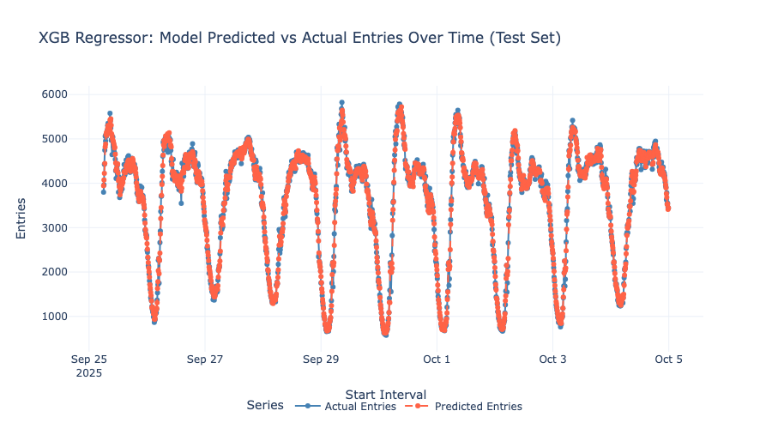
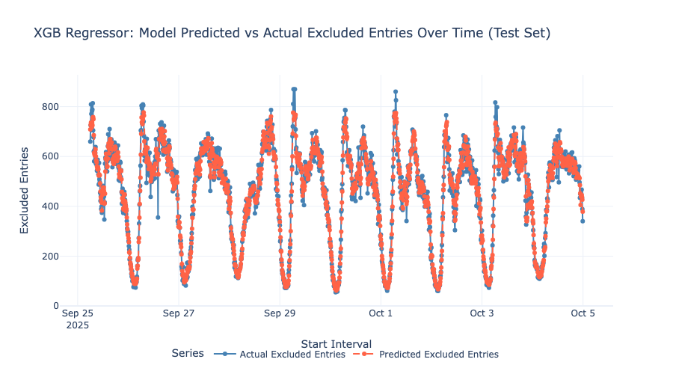
XGB vs. RF
Notes:
XGB does much better at capturing extreme points for entries than Random Forest, but still tends to miss them for excluded_entries, consistent with the generally weaker performance on that target.

Slide 23
06
Next Steps

Slide 24
Ideas
To address cluster generalizability:
A hyperparameter combination for more stable, medium-sized clusters
Alternative distance metrics (e.g., Manhattan) better-suited to high-dim/sparse data
Soft cluster assignments based on probabilities generated by HDBSCAN
To address extreme points:
Integrate additional external factors tied to traffic (subway + weather + holidays)
Complement or substitute clustering with anomaly detection (Isolation Forests)
Adjust regression hyperparameters to be more sensitive to outliers
Notes:
To address the clustering generalizability, we could try a hyperparameter combination somewhere between the previous and current, test alternative distance metrics more suitable to sparse data, and give validation and test noise points more flexible assignments based on probabilities.
To address extreme points, we could integrate additional external factors tied to traffic patterns, add explicit anomaly-detection approaches, or make the model itself slightly more sensitive to outliers.

Slide 25
Thank You!

Slide 26
References
[1] P. Miner, B. M. Smith, A. Jani, G. McNeill, and A. Gathorne-Hardy, “Car harm: A global review of automobility’s harm to people and the environment,” Journal of Transport Geography, vol. 115, p. 103817, Feb. 2024, doi: 10.1016/j.jtrangeo.2024.103817.
[2] “Congestion Relief is Unlocking a Better New York,” MTA. https://congestionreliefzone.mta.info/ (accessed Oct. 01, 2025).
[3] “Initial data from Congestion Relief Tolling,” Environment & Health Data Portal. https://a816-dohbesp.nyc.gov/IndicatorPublic/data-stories/congestion-tolling-update/ (accessed Oct. 01, 2025).
[4] Bureau of Policy and Research and S. M. Stringer, “The human cost of subway delays: A survey of New York City riders,” report, Jul. 2017. [Online]. Available: https://comptroller.nyc.gov/wp-content/uploads/documents/The-Human-Cost-of-Subway-Delays.pdf
[5] Y. Li and C. Shahabi, “A brief overview of machine learning methods for short-term traffic forecasting and future directions,” SIGSPATIAL Special, vol. 10, no. 1, pp. 3–9, Jun. 2018, doi: 10.1145/3231541.3231544.
[6] S. Cohen PhD, “The success and challenges of congestion pricing in New York City,” Columbia University School of Professional Studies, Jul. 21, 2025. [Online]. Available: https://sps.columbia.edu/news/success-and-challenges-congestion-pricing-new-york-city
[7] “Time Series Forecasting with Random Forest,” Statworx, Sep. 25, 2019. https://www.statworx.com/en/content-hub/blog/time-series-forecasting-with-random-forest
[8] N. Arya, “Random Forest Regressor,” KD Nuggets, Jul. 25, 2022. https://www.kdnuggets.com/2022/07/random-forest-algorithm-need-normalization.html
[9] “Is it necessary to normalize data for XGBoost?,” Data Science Stack Exchange, https://datascience.stackexchange.com/questions/60950/is-it-necessary-to-normalize-data-for-xgboost (accessed Nov. 29, 2025).
[10] A. Awan, “Understanding dimensionality reduction,” DataCamp, Jan. 21, 2025. https://www.datacamp.com/tutorial/understanding-dimensionality-reduction
[11] “Factor analysis of mixed data,” RPubs, https://rpubs.com/aliro/831890 (accessed Nov. 5, 2025).
[12] T. LaViale, “Understanding HDBSCAN: A Deep Dive into Hierarchical Density-Based Clustering,” Arize AI, https://arize.com/blog-course/understanding-hdbscan-a-deep-dive-into-hierarchical-density-based-clustering/ (accessed Nov. 5, 2025).
[13] M. Ali, “Clustering in Machine Learning: 5 Essential Clustering Algorithms,” DataCamp, Aug. 09, 2022. https://www.datacamp.com/blog/clustering-in-machine-learning-5-essential-clustering-algorithms
[14] A. Bajaj, “Anomaly detection in time series,” neptune.ai, Apr. 24, 2025. https://neptune.ai/blog/anomaly-detection-in-time-series
[15] J. Korstanje, “How to select a model for your Time Series Prediction Task [Guide],” neptune.ai, Apr. 22, 2025. https://neptune.ai/blog/select-model-for-time-series-prediction-task
[16] “1.11. Ensembles: Gradient boosting, random forests, bagging, voting, stacking,” scikit-learn, https://scikit-learn.org/stable/modules/ensemble.html (accessed Nov. 5, 2025).
[17] B. P. C., “Hyperparameter Tuning: GridSearchCV and RandomizedSearchCV, Explained,” KD Nuggets, Nov. 23, 2023. https://www.kdnuggets.com/hyperparameter-tuning-gridsearchcv-and-randomizedsearchcv-explained
[18] “XGBoost for Regression,” Machine Learning Mastery, https://machinelearningmastery.com/xgboost-for-regression/ (accessed Nov. 29, 2025).
[19] A. Singh, “Decoding Distance: Understanding Euclidean and Manhattan Metrics,” Kaggle, https://www.kaggle.com/discussions/general/576329 (accessed Nov. 29, 2025).

